Slide 1
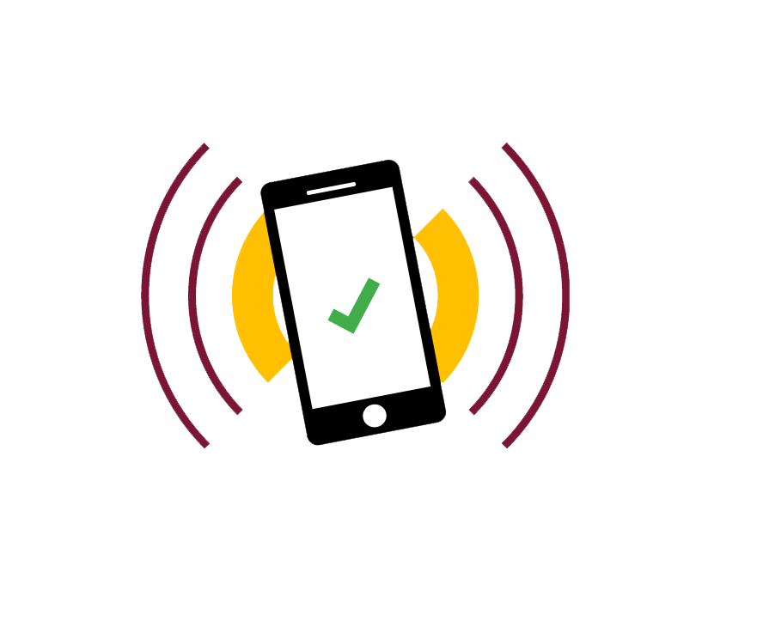
Design Presentation
App Name : TurnUp
Group Number : 27
Group Tutor : Simon Taylor
Group Members :
Loredana Vadana
Shreyas Jain
Maedin Zekarias
Taqi Tazwar
Thomas Hunt
Mark Andrews
TurnUp

Slide 2
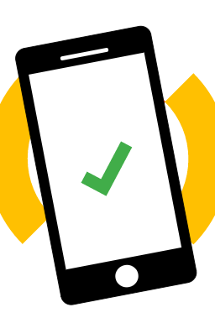
Contents
Software development process
HCI Model
How it works?
Pros & Cons
Exchange of information
Use cases
Prototype

Slide 3
Software development Process
We are focusing on the customer needs and interacting with the customer during our app development.
Our design is keeping up with any encountering changes within the system.
SCRUM approach
Establish our project objectives: developing an attendance app that uses NFC technology
We rely on self-organizing skills, there is no overall team leader, we help each other to perform at the highest level.
We progress through sprint cycles:
Decide on what we can work and create a “to do” list;
Test and integrate into the product;
Attend short meetings to discuss progress and identify issues;
Conduct a review and demonstrate our work to the tutor.

Slide 4
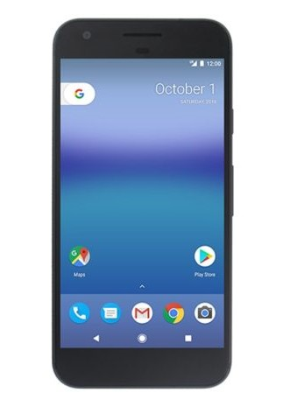

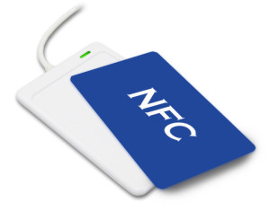
HCI Model
Lecture Information
Sends Information
For History Screen
Tap Phone
Sends Information
to server
NFC Tag
User’s Phone
Server

Slide 5
How it works?
User and Lecturer can register using their ID details.
App gets timetable data from API (if we can get it) or we will input it manually.
NFC Chip for Each Lecture, containing the lecture Information.
User Taps the phone to get the lecture details.
The app sends the details to the server to register user.
Server sends back the history to display on history page.
Server sends registration details to lecturer.

Slide 6
Pros & Cons
Pros :
No need of student ID to register.
Convinient for lecturer to manage attendance.
No need of tablet to manage the attendance.
Cons :
Need NFC for every Lecture, or changing details every time on the chip.
Only on Android (For now).

Slide 7
Exchange of Information
NFC to Phone
Lecture Name, Date & Time of the Lecture, Lecturer Name.
Phone to Server
NFC Details, Student name, Student ID, Date & Time of attendance.
Server to User
History of attendance
Server to Lecturer
Attended student’s ID, Student Name, Date & Time, NFC Details.

Slide 8


Use Cases
Creates Account
Creates Account
Check timetable
Get alerts for upcoming classes
Can Check Student Attendance
Can Register Using Phone
Can Export Attendance as Excel File
STUDENT
LECTURER
Can Check Attendance History

Slide 9
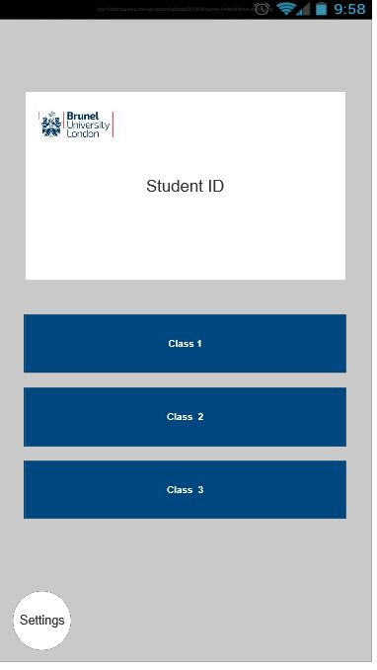
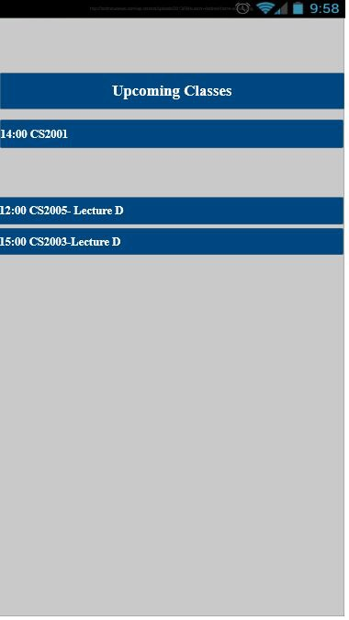

Prototype
Swipe left
Main Screen
Upcoming Lecture
Screen

Slide 10
Thank You!
TurnUp

